Slide 1


Introduction to Computer Science
Reichman University
Lecture 4-2
Arrays, Part II
How Java Manages Arrays and Strings:
A Low-Level Perspective
Notes:
‹#›

Slide 2
How Java handles strings
high-level abstraction
low-level implementation
...
int n = 100;
String s = "zehu";
s = s + 'z';
s = s + 'e';
System.out.println(s); // zehuze
s = s.replace('z', 'm');
System.out.println(s); // mehume
...
RAM
...
n
10
100
s
"zehu"
Reclaimed by Java’s Garbage Collector
"zehuz"
...
"zehuze"
"mehume"
Garbage Collector
A process that runs in the background (part of Java’s runtime system)
Collects “orphan” objects (arrays, strings, …) that have no variables pointing at them
Recycles the memory held by these objects.

Slide 3
How Java handles arrays
high-level abstraction
low-level implementation
...
int n = 100;
int[] a = {1, 2, 3};
a = reverse(a);
...
int[] b = a;
b[1] = 8;
System.out.println(a[1]); // 8
...
// Returns the elements of arr, reversed
public static int[] reverse(int[] arr) {
// Code omitted
}
...
RAM
...
n
10
100
a
1 2 3
dangerous code
b
3 8 1
...

Slide 4
How Java handles arrays
high-level abstraction
low-level implementation
...
int n = 100;
int[] a = {1, 2, 3};
a = reverse(a);
...
int[] b = a;
b[1] = 8;
System.out.println(a[1]); // 8
...
// Returns the elements of arr, reversed
public static int[] reverse(int[] arr) {
// Code omitted
}
...
RAM
...
n
10
100
a
1 2 3
b
3 8 1
...
Recap
String variables and array variables are references (contain addresses)
Arrays: Changes to the array elements remain “in place” (within the same memory block)
String: Changes to the string result in creating a new string (a new memory block).

Slide 5
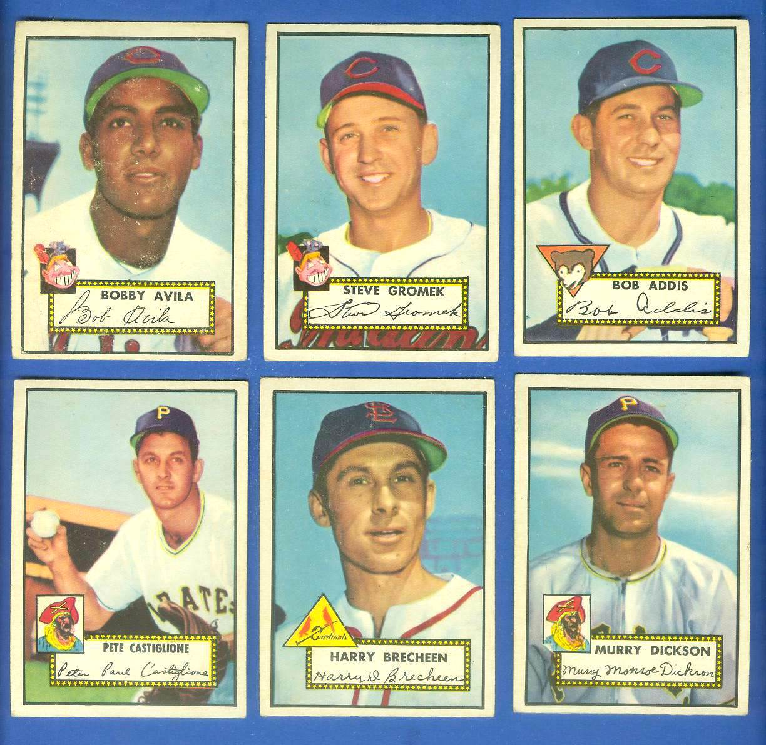


Introduction to Computer Science
Shimon Schocken
IDC Herzliya
Lecture 4-2
Arrays, Part III
Arrays in action: Application examples
Notes:
‹#›

Slide 6

Application example: Coupon collector problem
Example
There are 100 different baseball cards.
Each cereal box contains one card.
How many cereal boxes do you have to buy until you collect all 100 cards?
Numerous applications in science and engineering
Coupon collector problem
How many times do you have to draw random integers between 0 and N-1 until every integer has been drawn at least once?
Numerous applications in science and engineering
Example: How many samples to draw until finding all the strains of a targeted virus / bacteria (drug planning)
N
% java CouponCollector 100
587
% java CouponCollector 100
538
% java CouponCollector 100
580

Slide 7
Coupon collector problem
Algorithm
found = boolean array[0, ..., N-1] // all false
count = 0
nDistinct = 0 // Counts how many distinct values where drawn so far
while nDistinct < N
draw a random int r from 0 to N-1
count++
if found[r] is false:
found[r] = true
nDistinct++
return count
// And hope that the loop will terminate…
N
% java CouponCollector 100
587
% java CouponCollector 100
538
% java CouponCollector 100
580
Coupon collector problem
How many times do you have to draw random integers between 0 and N-1 until every integer has been drawn at least once?

Slide 8
Coupon collector problem: implementation
// Computes How many times you have to draw random integers between
// 0 and N-1 until all integers 0,1,2 ,…, N-1 have been drawn
public class CouponCollector {
public static void main(String[] args) {
int N = Integer.parseInt(args[0]);
int count = 0; // number of values drawn so far
int nDistinct = 0; // number of distinct values drawn so far
boolean[] found = new boolean[N];
for (int i = 0; i < N; i++) found[i] = false;
// Runs the simulation (note: this loop may never terminate)
while (nDistinct < N) {
// Draws a random integer between 0 and N-1, and updates the relevant counters
int val = (int) (Math.random() * N);
count++;
if (found[val] == false) {
found[val] = true;
nDistinct++;
}
}
// All the numbers between 0 and N-1 have been collected!
System.out.println(count);
}
}
N
% java CouponCollector 100
587
% java CouponCollector 100
538
% java CouponCollector 100
580

Slide 9
Coupon collector: Experiment
N
T: number of trials
% java CCExperiment 2 10
Average number of trials to obtain 2 values: 2.8
% java CCExperiment 2 10
Average number of trials to obtain 2 values: 5.1
% java CCExperiment 2 10
Average number of trials to obtain 2 values: 4.0
% java CCExperiment 2 1000000
Average number of trials to obtain 2 values: 2.998388
% java CCExperiment 2 1000000
Average number of trials to obtain 2 values: 3.002255
% java CCExperiment 2 1000000
Average number of trials to obtain 2 values: 2.997449
N = 10,
high variance
N = 100000,
low variance
Another example of the “Law of Large Numbers”

Slide 10
Coupon collector: Experiment
public class CCExperiment {
public static void main(String[] args) {
final int N = Integer.parseInt(args[0]); // number of values (“final”: cannot be mutated)
final int T = Integer.parseInt(args[1]); // number of trials
double sum = 0;
for (int t = 0; t < T; t++) {
sum = sum + couponCollector(N);
}
System.out.println("Average number of trials to obtain " + N + " values: " + sum / T );
}
// Computes how many times you have to draw random integers between 0 and N-1 until every integer has been drawn
public static int couponCollector(int N) {
int count = 0; // number of values drawn so far
int nDistinct = 0; // number of distinct values drawn so far
boolean[] found = new boolean[N];
for (int i=0; i<N; i++) found[i] = false;
// Runs the simulation
while (nDistinct < N) {
// Draws a random integer between 0 and N-1 and updates // the relevant counters
int val = (int) (Math.random() * N);
count++;
if (!found[val]) {
nDistinct++;
found[val] = true;
}
}
// All the values between 0 and N-1 have been collected
return count;
}
% java CCExperiment 2 10 // 10 = number of trials
Average number of trials to obtain 2 values: 2.8
% java CCExperiment 2 10
Average number of trials to obtain 2 values: 5.1
% java CCExperiment 2 10
Average number of trials to obtain 2 values: 4.0
% java CCExperiment 2 1000000
Average number of trials to obtain 2 values: 2.998388
% java CCExperiment 2 1000000
Average number of trials to obtain 2 values: 3.002255
% java CCExperiment 2 1000000
Average number of trials to obtain 2 values: 2.997449

Slide 11

Prime numbers
Prime: an integer > 1 whose only divisors (aka factors) are 1 and itself.
2, 3, 5, 7, 11, 13, 17, ..., 1013, ..., 2398120761, ..., ?
October 12, 2024
Luke Durant finds the largest known prime number: 2¹³⁶²⁷⁹⁸⁴¹ − 1,
(a number that has 41,024,320 digits). Spent $2M on the project.

Slide 12
The thinning of the primes
Prime: an integer > 1 whose only divisors (aka factors) are 1 and itself.
The thinning of the primes
The primes between 1 and 20: 2, 3, 5, 7, 11, 13, 17
The primes between 980 and 1000: 983, 991, 997
The primes between 9980 and 10000: none
Observation: As we go further along the number line, the primes seem to thin out (though they never run out)
Proof: One of the most important open problems in mathematics
Illustration: Next few slides

Slide 13
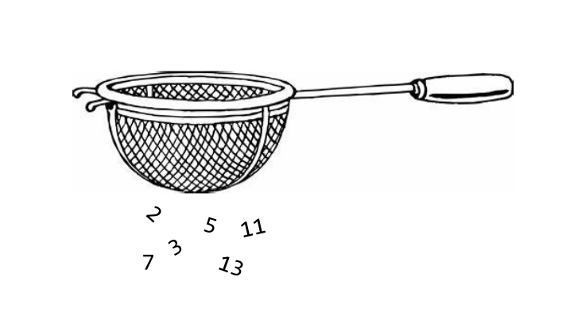
Sieve of Eratosthenes: Algorithm
An algorithm for finding all the primes numbers up to a given number n
Discovered 2,200 years ago, still being used by modern computers
Well known for its simplicity and efficiency.

Slide 14
Sieve of Eratosthenes: Algorithm (~200 BCE)
initialize: build a Boolean array of size n + 1 and set all the elements with index > 1 to true:
0
1
2
3
4
5
6
7
8
9
10
11
12
13
14
15
16
17
18
19
isPrime
T
T
T
T
T
T
T
T
T
T
F
F
T
T
T
T
T
T
T
T
...
Cross out all the multiples of p = 2:
0
1
2
3
4
5
6
7
8
9
10
11
12
13
14
15
16
17
18
19
isPrime
F
T
F
T
F
T
F
T
F
T
F
F
T
T
F
T
F
T
F
T
...
Cross out all the multiples of the next prime p = 3 (the next index which was not crossed out already):
0
1
2
3
4
5
6
7
8
9
10
11
12
13
14
15
16
17
18
19
isPrime
F
T
F
T
F
F
F
T
F
T
F
F
T
T
F
T
F
T
F
F
...
Cross out all the multiples of the next prime p = 5 (the next index which was not crossed out already):
0
1
2
3
4
5
6
7
8
9
10
11
12
13
14
15
16
17
18
19
isPrime
F
T
F
T
F
F
F
T
F
T
F
F
T
T
F
T
F
T
F
F
...
Keep incrementing p (skipping indexes that were already crossed) until p > sqrt(n)
When done: the indexes of all the surviving true values are primes:
2
3
5
7
11
13
17
19
isPrime
F
T
F
T
F
F
F
T
F
T
F
F
T
T
F
T
F
T
F
F
...

Slide 15
Sieve of Eratosthenes: Implementation
public class Primes {
public static void main(String[] args) {
final int N = Integer.parseInt(args[0]);
// Put your code here
}
}
% java Primes 25
2
3
5
7
11
13
17
19
23
There are 9 primes between 2 and 25. (36% are primes)

Slide 16
The thinning of the primes
Proposition
As we go further along the number line, the primes thin out (become more and more rare)
% java Primes 100
There are 25 primes between 2 and 100. (25% are primes)
% java Primes 100000
There are 9592 primes between 2 and 100000. (9% are primes)
% java Primes 1000000000
There are 50847534 primes between 2 and 1000000000. (5% are primes)
Conclusion
The experiment seems to support the proposition.

Slide 17
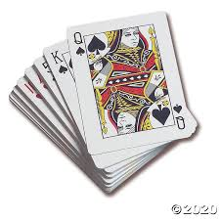
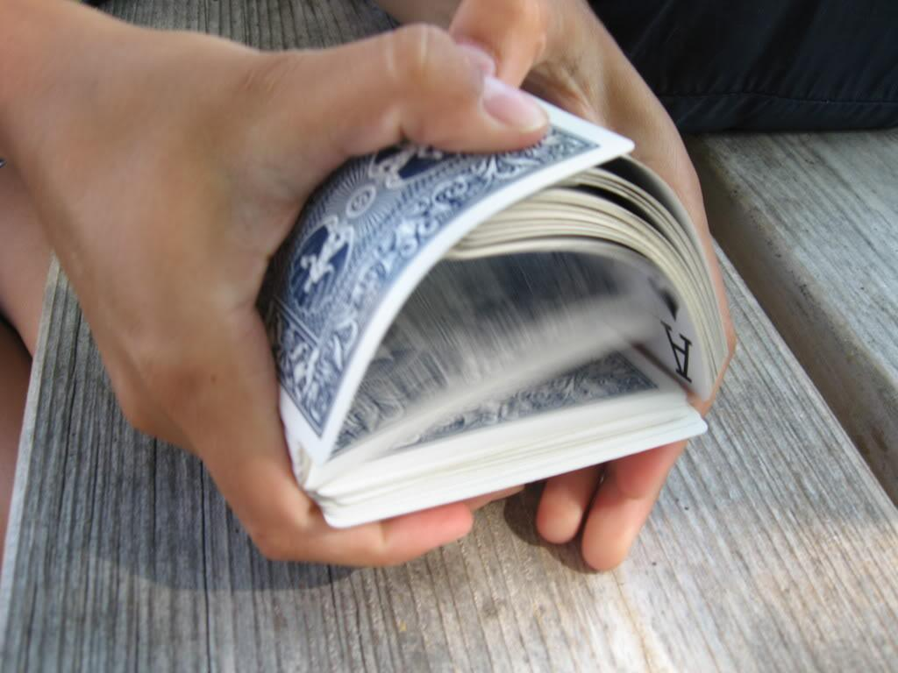
Application example: Shuffling
Tasks
Building a deck of cards
Shuffling a deck of cards

Slide 18
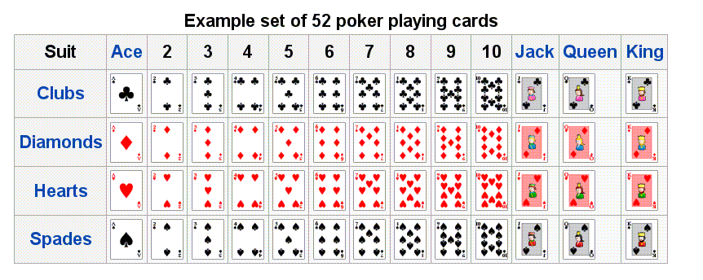
Building a deck of cards
public class Deck {
public static void main(String[] args) {
// Builds a deck of cards
String[] rank = {"2", "3", "4", "5", "6", "7", "8", "9",
"10", "Jack", "Queen", "King", "Ace"};
String[] suit = {"Clubs", "Diamonds", "Hearts", "Spades"};
...
% java Deck
2 of Clubs
2 of Diamonds
2 of Hearts
2 of Spades
3 of Clubs
3 of Diamonds
3 of Hearts
3 of Spades
4 of Clubs
4 of Diamonds
4 of Hearts
4 of Spades
5 of Clubs
5 of Diamonds
...
Ace of Clubs
Ace of Diamonds
Ace of Hearts
Ace of Spades
4 of Hearts
Builds and prints a deck of cards,
then selects and prints a random card
rank
0 1 2 3 4 ...
0
suit
1
2
3

Slide 19
Building a deck of cards
public class Deck {
public static void main(String[] args) {
// Builds a deck of cards
String[] rank = {"2", "3", "4", "5", "6", "7", "8", "9",
"10", "Jack", "Queen", "King", "Ace"};
String[] suit = {"Clubs", "Diamonds", "Hearts", "Spades"};
String[] deck = new String[52];
for (int i = 0; i < rank.length; i++)
for (int j = 0; j < suit.length; j++)
deck[4 * i + j] = rank[i] + " of " + suit[j];
% java Deck
2 of Clubs
2 of Diamonds
2 of Hearts
2 of Spades
3 of Clubs
3 of Diamonds
3 of Hearts
3 of Spades
4 of Clubs
4 of Diamonds
4 of Hearts
4 of Spades
5 of Clubs
5 of Diamonds
...
Ace of Clubs
Ace of Diamonds
Ace of Hearts
Ace of Spades
4 of Hearts
mapping a 2D index to a 1D index
rank
0 1 2 3 4 ...
0
suit
1
2
3

Slide 20
Building a deck of cards
public class Deck {
public static void main(String[] args) {
// Builds a deck of cards
String[] rank = {"2", "3", "4", "5", "6", "7", "8", "9",
"10", "Jack", "Queen", "King", "Ace"};
String[] suit = {"Clubs", "Diamonds", "Hearts", "Spades"};
String[] deck = new String[52];
for (int i = 0; i < rank.length; i++)
for (int j = 0; j < suit.length; j++)
deck[4 * i + j] = rank[i] + " of " + suit[j];
// Prints the deck
for (int i = 0; i < 52; i++) {
System.out.println(deck[i]);
}
System.out.println();
// Selects and prints a random card
System.out.println(deck[(int) (Math.random() * 52)]);
...
% java Deck
2 of Clubs
2 of Diamonds
2 of Hearts
2 of Spades
3 of Clubs
3 of Diamonds
3 of Hearts
3 of Spades
4 of Clubs
4 of Diamonds
4 of Hearts
4 of Spades
5 of Clubs
5 of Diamonds
...
Ace of Clubs
Ace of Diamonds
Ace of Hearts
Ace of Spades
4 of Hearts

Slide 21
Shuffling
% java Deck
10 of Diamonds
King of Spades
2 of Spades
3 of Clubs
4 of Spades
Queen of Clubs
2 of Hearts
7 of Diamonds
6 of Spades
Queen of Spades
3 of Spades
Jack of Diamonds
6 of Diamonds
8 of Spades
9 of Diamonds
...
6 of Spades
% java Deck
3 of Clubs
6 of Diamonds
3 of Spades
Jack of Hearts
8 of Spades
4 of Spades
2 of Hearts
7 of Diamonds
6 of Spades
10 of Diamonds
King of Spades
2 of Spades
3 of Spades
Jack of Diamonds
6 of Diamonds
...
4 of Diamonds
% java Deck
5 of Clubs
Jack of Hearts
9 of Spades
10 of Spades
9 of Clubs
7 of Spades
6 of Diamonds
7 of Hearts
7 of Clubs
5 of Spades
4 of Spades
Queen of Diamonds
5 of Diamonds
Jack of Clubs
Ace of Hearts
...
10 of Hearts
Each time you run this program, it outputs a shuffled deck of cards
Notes:
Knuth shuffle more sophisticated than it appears
introduce swap idiom
shuffle is random by choosing from cards not yet selected

Slide 22
Shuffling
Goal: given an array deck of size N,
rearrange its elements in random order.
% java Deck
5 of Clubs
Jack of Hearts
9 of Spades
10 of Spades
9 of Clubs
7 of Spades
6 of Diamonds
7 of Hearts
7 of Clubs
5 of Spades
4 of Spades
Queen of Diamonds
5 of Diamonds
Jack of Clubs
Ace of Hearts
...
10 of Hearts
Notes:
Knuth shuffle more sophisticated than it appears
introduce swap idiom
shuffle is random by choosing from cards not yet selected

Slide 23
Shuffling
Goal: given an array deck of size N,
rearrange its elements in random order.
Shuffling algorithm:
for i = 0 ... N – 1:
Pick a random int r from i to N – 1
Swap cards deck[i] and deck[r]
% java Deck
5 of Clubs
Jack of Hearts
9 of Spades
10 of Spades
9 of Clubs
7 of Spades
6 of Diamonds
7 of Hearts
7 of Clubs
5 of Spades
4 of Spades
Queen of Diamonds
5 of Diamonds
Jack of Clubs
Ace of Hearts
...
10 of Hearts
Notes:
Knuth shuffle more sophisticated than it appears
introduce swap idiom
shuffle is random by choosing from cards not yet selected

Slide 24
Shuffling
Goal: given an array deck of size N,
rearrange its elements in random order.
Shuffling algorithm:
for i = 0 ... N – 1:
Pick a random int r from i to N – 1
Swap cards deck[i] and deck[r]
% java Deck
5 of Clubs
Jack of Hearts
9 of Spades
10 of Spades
9 of Clubs
7 of Spades
6 of Diamonds
7 of Hearts
7 of Clubs
5 of Spades
4 of Spades
Queen of Diamonds
5 of Diamonds
Jack of Clubs
Ace of Hearts
...
10 of Hearts
// Shuffles the deck
for (int i = 0; i < N – 1; i++) {
// Selects a random number between i and N-1
int r = i + (int) (Math.random() * (N-i));
// Swaps cards r and card i
String temp = deck[r];
deck[r] = deck[i];
deck[i] = temp;
}

Slide 25
Final version
public class Deck {
public static void main(String[] args) {
// Builds a deck of cards
String[] suit = { "Clubs", "Diamonds", "Hearts", "Spades" };
String[] rank = { "2", "3", "4", "5", "6", "7", "8", "9",
"10", "Jack", "Queen", "King", "Ace" };
int Nsuit = suit.length
int Nrank = rank.length;
int N = Nsuit * Nrank;
String[] deck = new String[N];
for (int i = 0; i < Nrank; i++)
for (int j = 0; j < Nsuit; j++)
deck[Nsuit * i + j] = rank[i] + " of " + suit[j];
// Shuffles the deck
for (int i = 0; i < N-1; i++) {
int r = i + (int) (Math.random() * (N-i));
String temp = deck[r];
deck[r] = deck[i];
deck[i] = temp;
}
// Prints the shuffled deck
for (int i = 0; i < N; i++)
System.out.println(deck[i]);
}
}
% java Deck
5 of Clubs
Jack of Hearts
9 of Spades
10 of Spades
9 of Clubs
7 of Spades
6 of Diamonds
7 of Hearts
7 of Clubs
5 of Spades
4 of Spades
Queen of Diamonds
5 of Diamonds
Jack of Clubs
Ace of Hearts
...
10 of Hearts
Notes:
Tedious exercise: do this without an array!
Note: suit.length gives number of elements in array suit[]

Slide 26
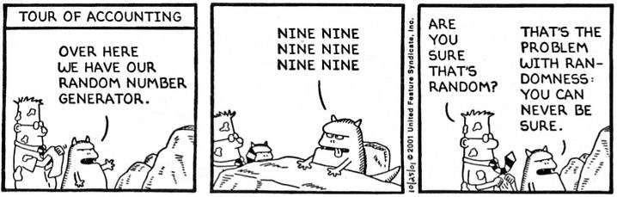
End comment
How can we tell that a deck is well shuffled?

Slide 27
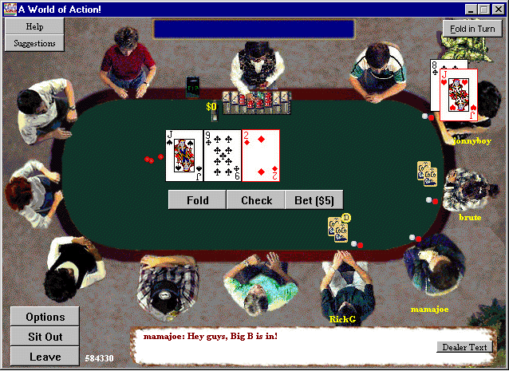
End comment
How PlanetPoker.com went broke:
In on-line poker, the card shuffling is done by the game software.
PlanetPoker.com used a naïve shuffling algorithm.
Clever players learned to exploit the weakness, and the company went bankrupt.
The article
Notes:
Other problems when playing online poker: corrupt casino, collusion among opponents, malicious player can intercept network traffic (if not encrypted).
You don't need to know much about the details of poker: all you have to know is the cards of all of your opponents...

Slide 28
Introduction to Computer Science
Reichman University
Lecture 4-2
Arrays, Part II
Arrays in action: Application Examples
Notes:
‹#›

